Slide 1
MARK_RECAPTURE METHOD PETERSON METHOD
Lab Ecología general

Slide 2
Capture-recapture
Peterson method
mark-recapture method
To estimate population size of any species, you can use a mark-recapture method which is based on the idea of simple algebra.
Where we do two surveys and in the first survey we mark (identify) each captured individuals in such a way that in the next time period we know that these individuals has already been seen in the first survey.
In the second survey we capture individuals and we identify the number of those that had been seen in the first survey. We need three information
• M = The number of individuals seen and marked in the first survey
• C = The total number of individuals captured in the second survey
• R = The number of recaptured individuals in the second survey

Slide 3
Lincoln-Peterson Method
N = Number of individual in population
M = the chosen sample, and Marked in the first survey
C = Total number of Ind. captured in the second survey
R = Number of Ind. recaptured in second survey

Slide 4
Re-arrange the formula

Slide 5
Assumptions
1. All individuals have equal probability of being captured
2. NO change in ratio of mark and un-marked individuals, so large changes in mortality, natality, immigration and emmigration.
3. Marked individuals distribute themselves randomly with respect to unmarked individuals

Slide 6
Unbiased Bias
Weber 1982
Bias of the results as a consequence of small samples size

Slide 7
Confidence Interval on the fraction of marked individuals

Slide 8
This method was first used by John Graunt (1620-1674) to estimate the population of London, UK, published

Slide 9
See the following website for more information,
https://en.wikipedia.org/wiki/John_Graunt. John Graunt
is one the first demographer but his career was as a haberdasher
(seller of sewing materials, such as buttons, zippers, ribbons, etc).
The first known ecological example is from C. G. J. Petersen 1896 to estimate the population size of fish. *
Petersen, C. G. J. (1896). “The Yearly Immigration of Young Plaice Into the Limfjord From the German
Sea”, Report of the Danish Biological Station (1895), 6, 5–84.

Slide 10
Introduction
Population dynamics studies the short and long-term changes in the size and age composition of populations, and the environment that influences those changes.
Varied application
control of invasive species,
assessing population declines
determining population viability

Slide 11
Mark-Recapture
Technique for estimating the population density of mobile animals.
A sample of the population is captured, marked, and released.
Assume:
marked individuals become randomly distributed
subsequent trapping is random
new sample contains representative proportion of marked an unmarked individuals.

Slide 12
Two methods for estimating population size:
(1) Petersen Method, and
(2) Modified Schnabel Method
Both methods for closed populations
No change in size due to births, deaths, immigration,or emigration.
Open populations fluctuate in size and composition

Slide 13
Lincoln–Petersen method
Simple method with a single episode of marking animals and a second single episode of recapturing individuals
Assumptions:
(1) Population is "closed", so N is constant.
(2) All animals have the same chance of getting caught
(3) Marking individuals does not affect catchability.
(4) Animals do not lose marks
(5) All marks are reported on discovery

Slide 14
What makes a population closed?
Dispersal barriers
Philopatry
Large surveyed area
Slow reproductive/death rate
Short time between surveys

Slide 15
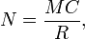
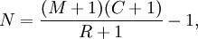
Equation
N = Population size
M = Total captured and marked on first visit
C = Number captured on the second visit
R = Number recaptured

Slide 16
Survey 1
Baised
N= (7*8)/3
N= 18.67
Unbaised
N= ((7+1*8+1)/3+1)-1
N= 17
M= 7
Survey 2
N= 20
C= 8
R= 3

Slide 17
When would Petersen give you a bad estimate?
Population not closed
Marked animals likely to be re-trapped
Unmarked animal unlikely to be re-trapped
Marked animals likely to die
Marks fall off
Positive:
Simplest model
Can estimate size in two visits
Negative:
Short time studies
Assumes closed population
Limited number of parameters

Slide 18
Confidence Intervals
yes
Is the ratio of R/C>0.10?
Use binomial confidence intervals
no
Is the number of recaptures R>50?
yes
Use the normal approximation
no
Use Poisson confidence intervals

Slide 19
Poisson example
Confidence intervals for R
Lower 95%= 0.818
Upper 95%= 8.102
M=7
C=8
R=3
N= 7*8/0.818= 68.5
N= 7*8/8.102= 6.92

Slide 20
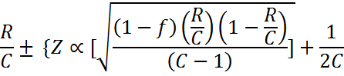
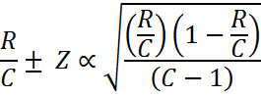
Normal Approximation
f= fraction of total populations sampled in the second sample = R/M
1/2C= correction for continuity
Z_{α}= standard normal derivate
= 1.96 for 95%
= 2.576 for 99%
Large sample and large population s
ize

Slide 21
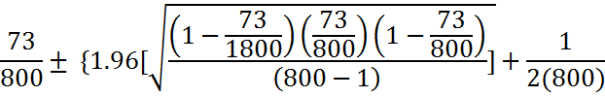
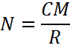
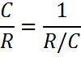
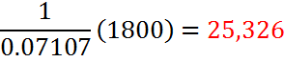
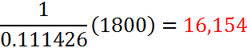
Example
M= 1800
C= 800
R=73
95% confidence intervals= 0.09125 ± 0.020176
R/C=0.07107 and 0.222426
Upper 95%= Lower 95%=

Slide 22
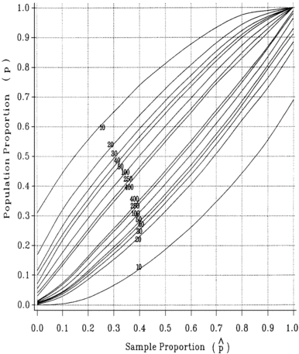

Slide 23
Binomial example
R/C= 14/22= 0.64
Lower 95%= 0.83
Upper 95%= 0.40
M= 50
C= 22
R=14
N= 1 (50) = 60
0.83
N= 1 (50) = 125
0.40

